Slide 1

Cancer Genomics working group

Slide 2



VISION
MISSION
PURPOSE
Advance the frontiers of cancer genomics research and capacity through development and application of innovative bioinformatics methodologies.
To Advance Excellence of Cancer Genomics Research through application of bioinformatics approaches.
Contribute towards reduced cancer burden in Uganda
Contribute valuable insights to the scientific community, improve patient outcomes, and empower the next generation of bioinformaticians and researchers in the field of cancer genomics and genetics

Slide 3
1. Recruit and mentor upcoming cancer researchers
OBJECTIVES
2. Identify relevant questions and data, and execute corresponding research to answer questions and publish the results
3. To actively identify and secure relevant grants and other resources to support cancer research

Slide 4

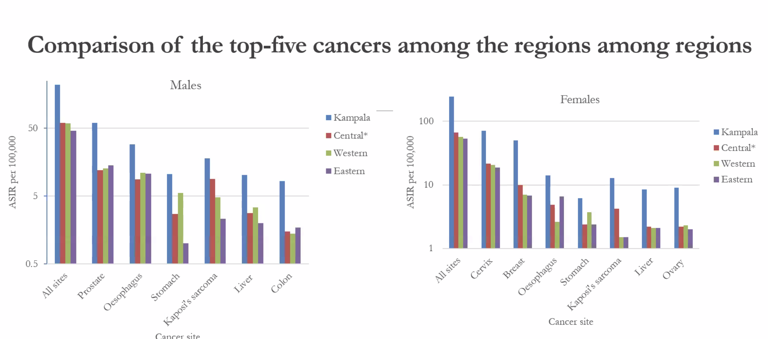
Cancers relevant or most prevalent in Uganda
Breast Cancer
Prostate Cancer
Cervical Cancer
Acute Myeloid Leukemia
Colon Cancer
Lung Cancer
Karposis Carcoma
Endemic Burkitt’s Lymphoma
SCOPE

Slide 5
Cancer Genetics
Focus on uncovering the impact of genomic variations to the pathophysiology, diagnosis, treatment and prognosis of cancer
Focus Topics
2. Cancer Immunogenetics
Focus on exploring the role of genetics in influencing the immune system to recognize and eliminate cancer cells.
Look forward to having this list expanded in the near future!

Slide 6
1. General Fundamental information sessions
Cancer Biology
Cancer Immunology
Diagnosis & Analysis Techniques
Survival curves (Kaplan-Meier curves)
ACTIVITIES
TO BE
COVERED
2. Research presentations (journal articles or projects)
3. Guest speakers - Quarterly (after every 3 months)
4. Exploration of cancer-related data resources and databases such as TCGA, GEO, NCBI, Metablic
4. Practical research projects: Build our practical skills and capacity in analyzing and interpreting cancer genomics data. Literature or meta-analyses
5. External engagement and collaborations like UCI-HCRI journal clubs

Slide 7


Weekly Meetings
MEETING FREQUENCY
&
PLAN
Week One
Week Two
Week Three
Week Four
Cancer Genetics
Cancer Immunogenetics
Organize a consolidation physical meeting once a month (After the 4 weeks session)

Slide 8




DOCUMENTATION
PUBLICITY
COMMUNICATION

